Slide 1
Global Suicide Rates A glimpse at geographic, global and Demographic trends
Data Analytics Bootcamp (T/Th Session)
Nireesha Abbineni
Mrinmayee Kulkarni
Allyssa Calhoun

Slide 2
Our process
We wanted to dive into an issue that had global significance. One that warranted a deeper look into trends, demographics, geographic analysis, and possible correlations
We were able to find the data we needed on Kaggle.com
https://www.kaggle.com/russellyates88/suicide-rates-overview-1985-to-2016
The dataset was compiled from four datasets:
United Nations Development Program. (2018). Human development index (HDI). Retrieved from http://hdr.undp.org/en/indicators/137506
World Bank. (2018). World development indicators: GDP (current US$) by country:1985 to 2016. Retrieved from http://databank.worldbank.org/data/source/world-development-indicators#
[Szamil]. (2017). Suicide in the Twenty-First Century [dataset]. Retrieved from https://www.kaggle.com/szamil/suicide-in-the-twenty-first-century/notebook
World Health Organization. (2018). Suicide prevention. Retrieved from http://www.who.int/mental_health/suicide-prevention/en/
The data was very comprehensive, however we did find a glitch in missing statistics for Baby Boomers in 2010.
We reported the flaw in the dataset to the Kaggle dataset.

Slide 3
Clean UP PRocess
Nireesha add your process here since you did all the dirty work.
We also used google API to utilize in our project to get a heatmap(chloropleth) for the findings on the global scale.

Slide 4
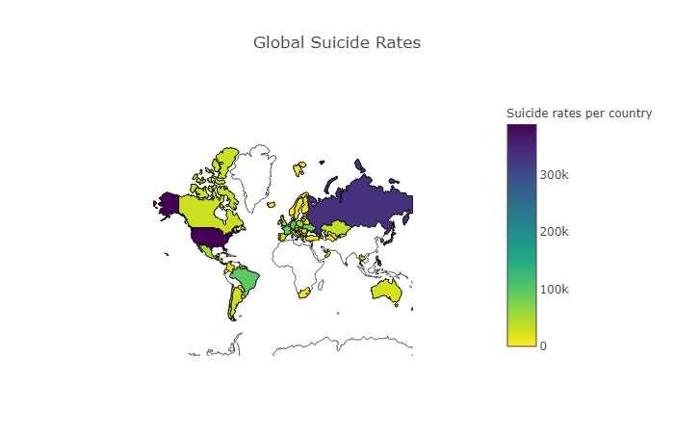
A global issue
Notes:
Insert a map of your country.

Slide 5
Top 3 Global findings from heat map
A look at global suicides over the last 10 years reveals the issue affects people everywhere.
The previous map of the data shows the rates across different countries.
It also gives a scale with the lowest to the highest incidence of suicides globally.
As we can see countries like United States, Russia,Japan and parts of Europe and South America are affected by a higher rate.
Notes:
Insert a picture of one of the geographic features of your country.

Slide 6
A deep dive into the top ten countries
Countries with the highest number of suicides
United States
Russian
Japan
South Korea
Germany
Brazil
France
Ukraine
Poland
Mexico

Slide 7
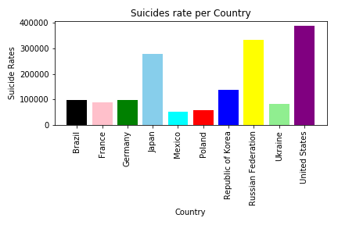
A wide spread issue
As we noticed from the global depiction as well as the bar graph here that the top 10 countries with higher suicide rates are as mentioned.
Out of these countries there is a significant rise in these rates with pre-dominantly 3 countries. Namely United States, Russian Federation and Japan.
Notes:
Insert a picture illustrating a season in your country.

Slide 8
Correlation between GDP and Suicide Rates
We were interested to determine if there was a statistically reliable correlation between GDP and Suicide Rates
Hypothesis was that the richer the country, the greater the rate
Based on Maslow’s Hierarchy of Needs
Fact: Hypothesis true? Should we use Null Hypothesis here?
Notes:
Insert a picture of an animal and or plant found in your country.

Slide 9
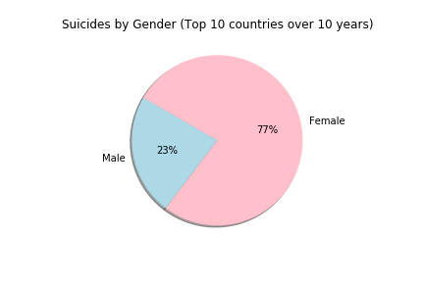
A look at gender disparity—(top 10)
We were surprised how much more prevalent suicide was among females.
Females accounted for 77% of all
suicides.
None of the top 10 countries were significantly more lopsided than others.
Notes:
Add key points in the history of your country to the timeline.

Slide 10
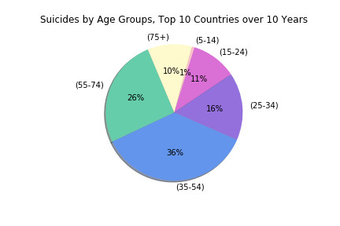
Are certain age groups more susceptible to suicide than others?
The 35-54 age group accounts for the largest segment to succumb to suicide
Perhaps because this is the age where we feel the strongest pressures financially, career-wise, and martially
At first glance, the 75+ group, comprising 10% of all suicides was surprising
A cursory look at other research suggest a terminal health diagnosis link to be primary cause among this age group
The saddest finding was the 10K children in the (5-14) bracket
Notes:
Insert a picture illustrating a custom or tradition here.

Slide 11
Histogram slide
Explain how laws are made and changed in your country. Tell how people are chosen to lead the country.
Notes:
Insert a picture of the head leader of your country.

Slide 12
United States

Slide 13
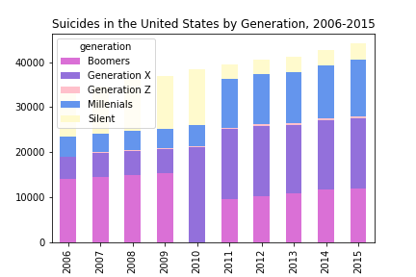
Suicides in the US by Generation
Gen Xers warrant a deeper dive into life stressors and mental issues in that generation
Part of the increase can be explained by them moving into the most dangerous age group for suicides, (35-54)
Numbers are especially alarming when this generations has 15 year birthyear span vs. some of the others (up to 21years)
The data appears to follow 2 separate trend lines. One from 2006-2010 and the other from 2011-2015
Perhaps separate original source datasets were used to compile original dataset
Notes:
Insert a picture that illustrates some part of your country’s economy.

Slide 14
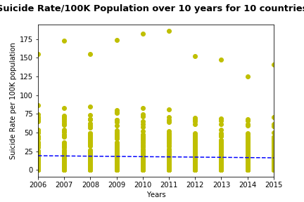
Statistical Analysis
Linear regression line for data of 10 countries over 10 years takes a little dip from 2010 to 2015.
But the overall rate is very much stagnant.
The median for suicide rate over-all is 732 and 10 per 100K population.
This difference in over-all and per 100K rate tells us the huge gap between the countries with higher rates than others.
Notes:
Insert a picture of one of the points of interest for your country.

Slide 15
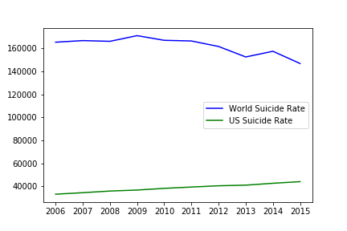
Conclusions
As per our questions we found out the top 10 countries with higher suicide rates.
With respect to US Vs World we delved deeper to get the correlation and found that towards 2015 as the global suicide rate is reducing the US rate is increasing unfortunately.

Slide 16
Conclusions
Dataset limitations found
Data Analytics Learnings

